Slide 1
Extending the Motulsky & Mahan Method: Alternative Orders of Reagent Addition
We help you analyze your pharmacology data
Sam Hoare, PhD
sam.hoare@pharmechanics.com
November 12 2018

Slide 2
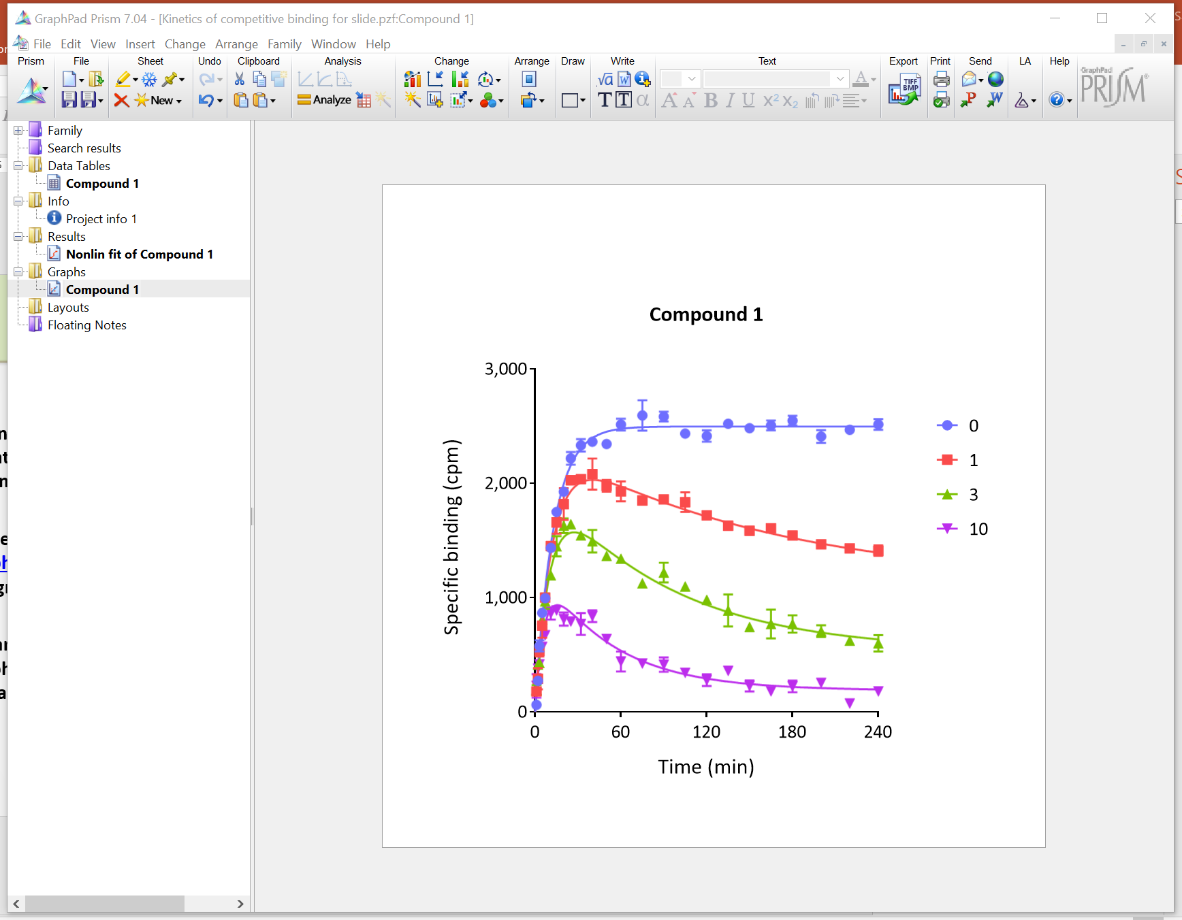
Outline
Extensions to the Motulsky and Mahan equation have recently been published to accommodate alternative assay formats.
These equations have been loaded into GraphPad Prism in a custom template designed by Pharmechanics.
We are grateful to Harvey Motulsky at GraphPad Software for guidance.

Slide 3
Notes
Download the Prism template from the Dropbox here.
In the template, the equation is loaded in and ready to use.
Questions? Email sam.hoare@pharmechanics.com
The equations are supported by Pharmechanics, not by GraphPad.

Slide 4
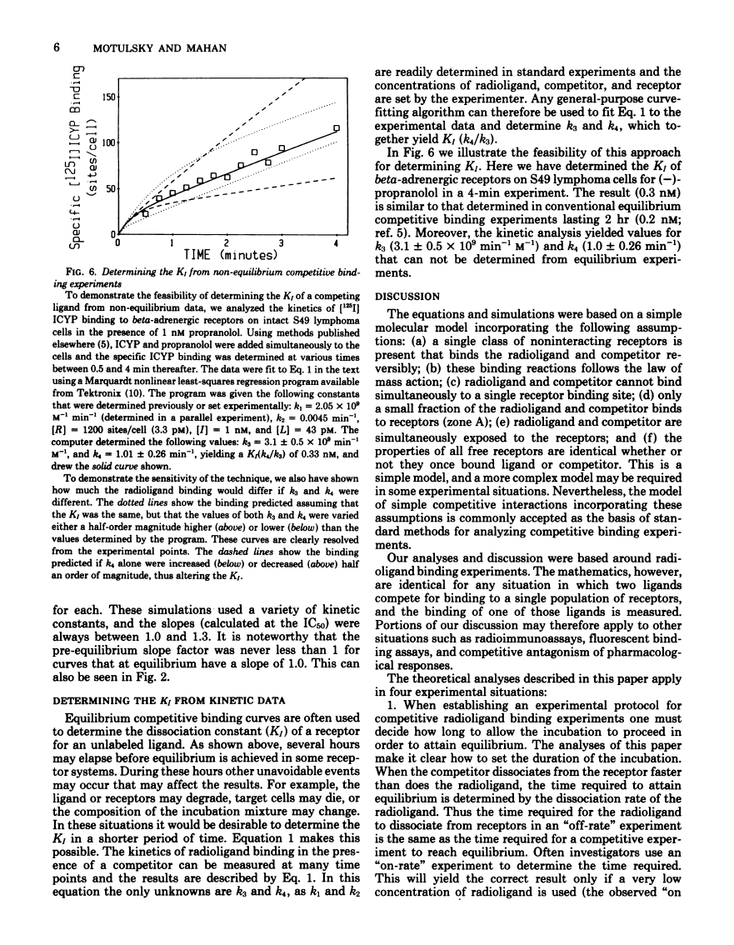
In the Motulsky & Mahan method, receptor is added last.
Motulsky and Mahan, Mol Pharm 1984

Slide 5
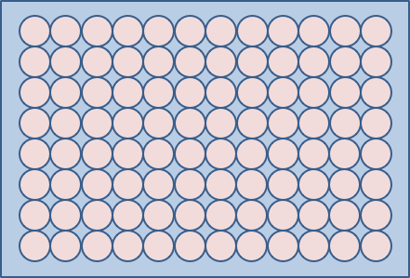
Motulsky & Mahan method setup
Compound & labeled ligand

Slide 6
Motulsky & Mahan method setup
Compound & labeled ligand
Add receptor
Measure at various times

Slide 7
Motulsky & Mahan method setup
Compound & labeled ligand
Add receptor
[Compound] (nM)
0
1.0
3.0
10
30
$${\left[RL\right]}_{t}=\frac{N\left[L\right]k_{1}}{K_{F}−K_{S}}\left[\frac{k_{4}\left(K_{F}−K_{S}\right)}{K_{F}K_{S}}+\frac{\left.k_{4}−K_{F}\right.}{K_{F}}e^{−K_{F}t}−\frac{\left.k_{4}−K_{S}\right.}{K_{S}}e^{−K_{S}t}\right]$$
Measure at various times

Slide 8
Alternative ordering of reagent addition
We may not want to add the receptor last.
Pre-plated cells. Convenient to add competitor first then hot ligand.
Very rapid hot ligand association. Convenient to add hot ligand first then competitor.
Ex vivo receptor occupancy. We expose receptor to competitor in vivo, prep the tissue, wash away unbound competitor, then add hot ligand.
The Motulsky and Mahan equation has been extended to handle these scenarios.

Slide 9
Equation for pre-incubation with competitor
Pre-incubate receptor & compound
See J Biomol Screen. 2016; 21:729-37
J Pharm Tox Methods. 2018; 89:26-38

Slide 10
Equation for pre-incubation with competitor
Pre-incubate receptor & compound
Add labeled ligand
Measure at various times
See J Biomol Screen. 2016; 21:729-37
J Pharm Tox Methods. 2018; 89:26-38

Slide 11
Equation for pre-incubation with competitor
Pre-incubate receptor & compound
Add labeled ligand
[Compound] (nM)
0
0.3
1.0
3.0
10
$${\left[RL\right]}_{t}=\frac{N\left[L\right]k_{1}}{K_{F}−K_{S}}\left[\frac{k_{4}\left(K_{F}−K_{S}\right)}{K_{F}K_{S}}+\frac{\left.k_{4}−K_{F}\right.}{K_{F}}e^{−K_{F}t}−\frac{\left.k_{4}−K_{S}\right.}{K_{S}}e^{−K_{S}t}\right]$$
$$−\frac{ρ_{I\left(t=0\right)}N\left[L\right]k_{1}}{K_{F}−K_{S}}\left(e^{−K_{S}.t}−e^{−K_{F}.t}\right)$$
Measure at various times
See J Biomol Screen. 2016; 21:729-37
J Pharm Tox Methods. 2018; 89:26-38

Slide 12
Using the new equations
Download and open “[Pharmechanics] New kinetics of competitive binding equations” from the Dropbox here.
The new equations are used in the same way as the “Kinetics of competitive binding” equation.
See following slides for screen clippings

Slide 13
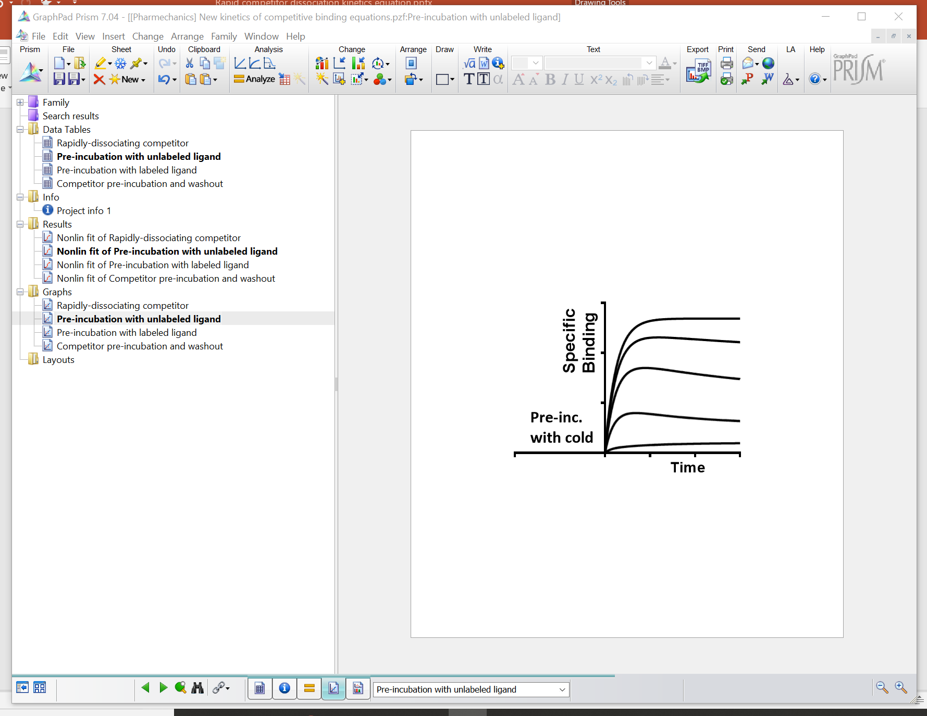
Select the equation you want

Slide 14
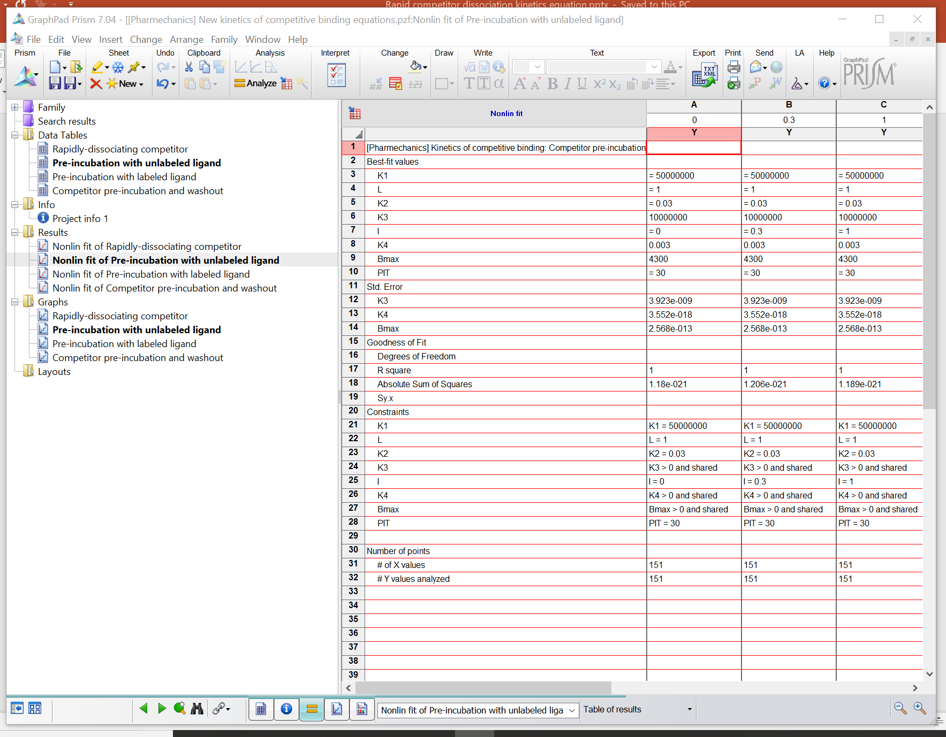
Click this icon

Slide 15
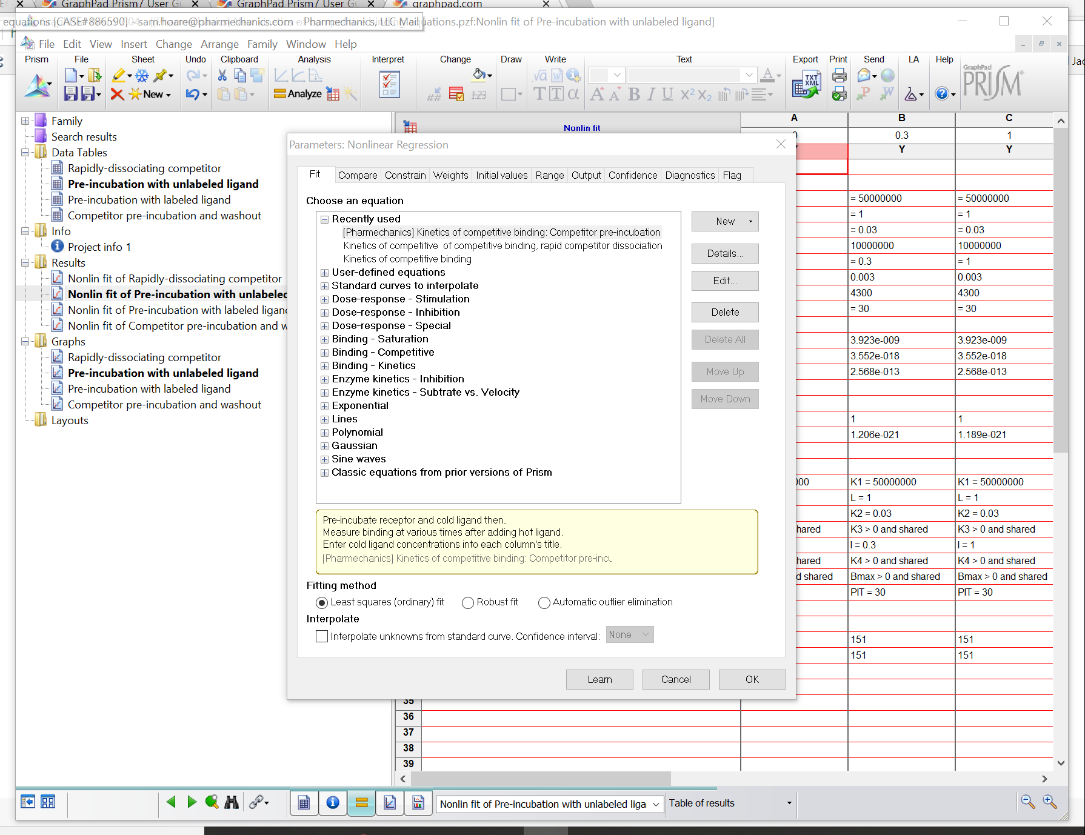
This process loads the equation into the “User-defined equations” list. It only needs to be done once. After that, the new equation will be available every time you open Prism.
Click OK then close file

Slide 16
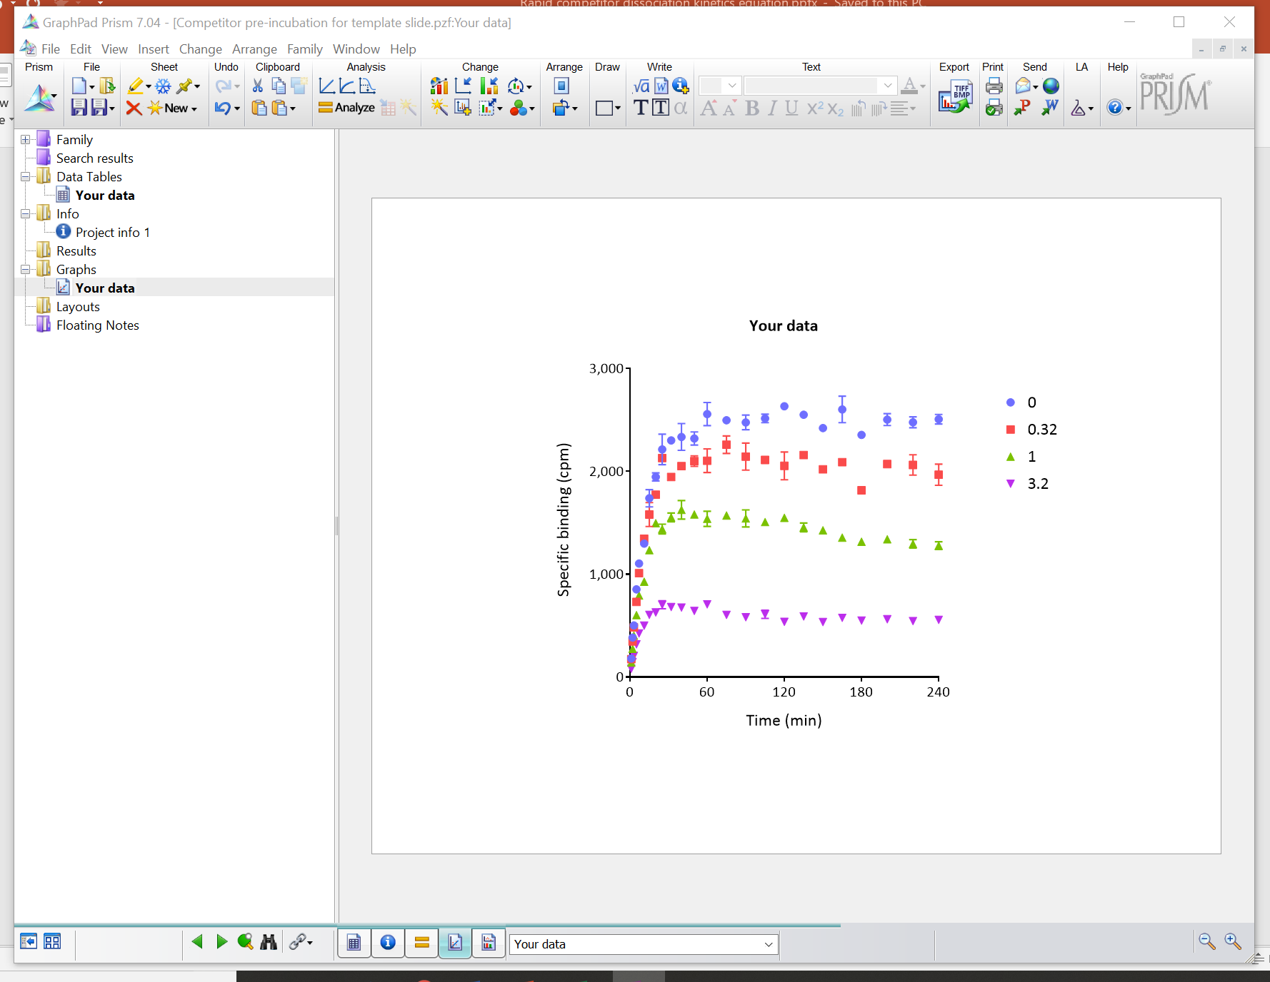
Open your file

Slide 17
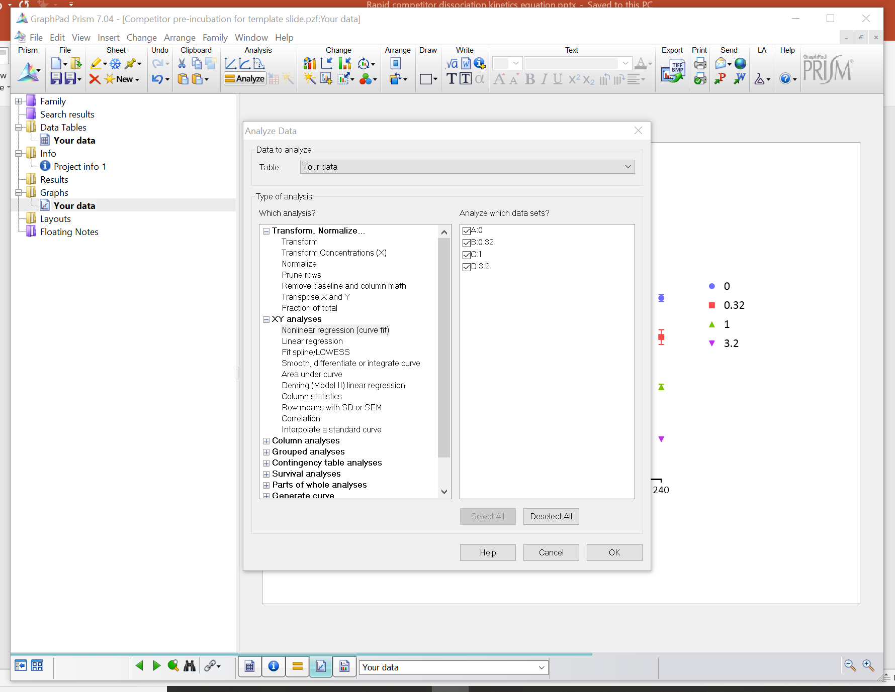

Slide 18
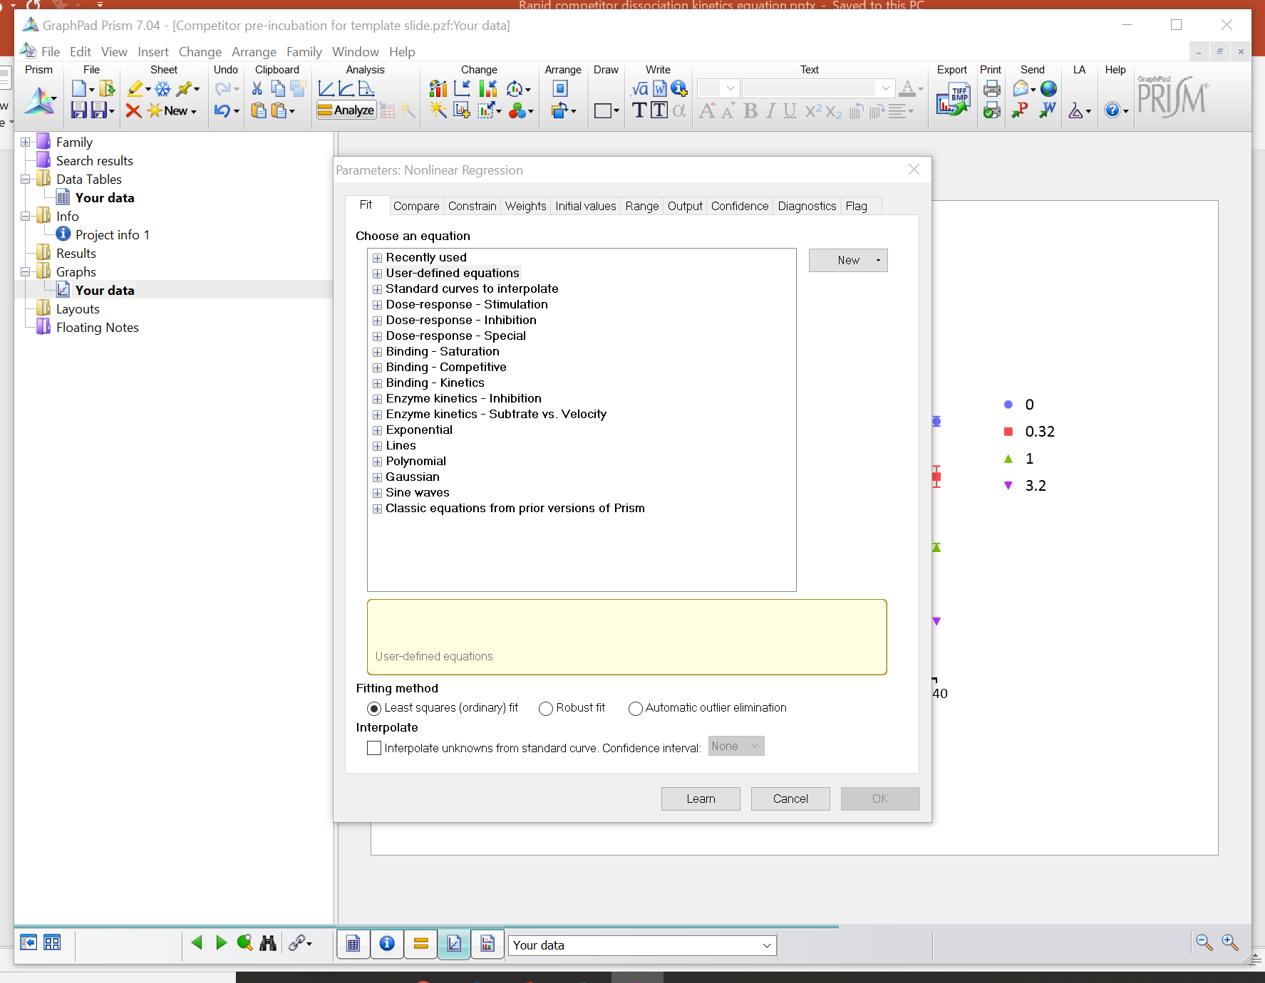

Slide 19
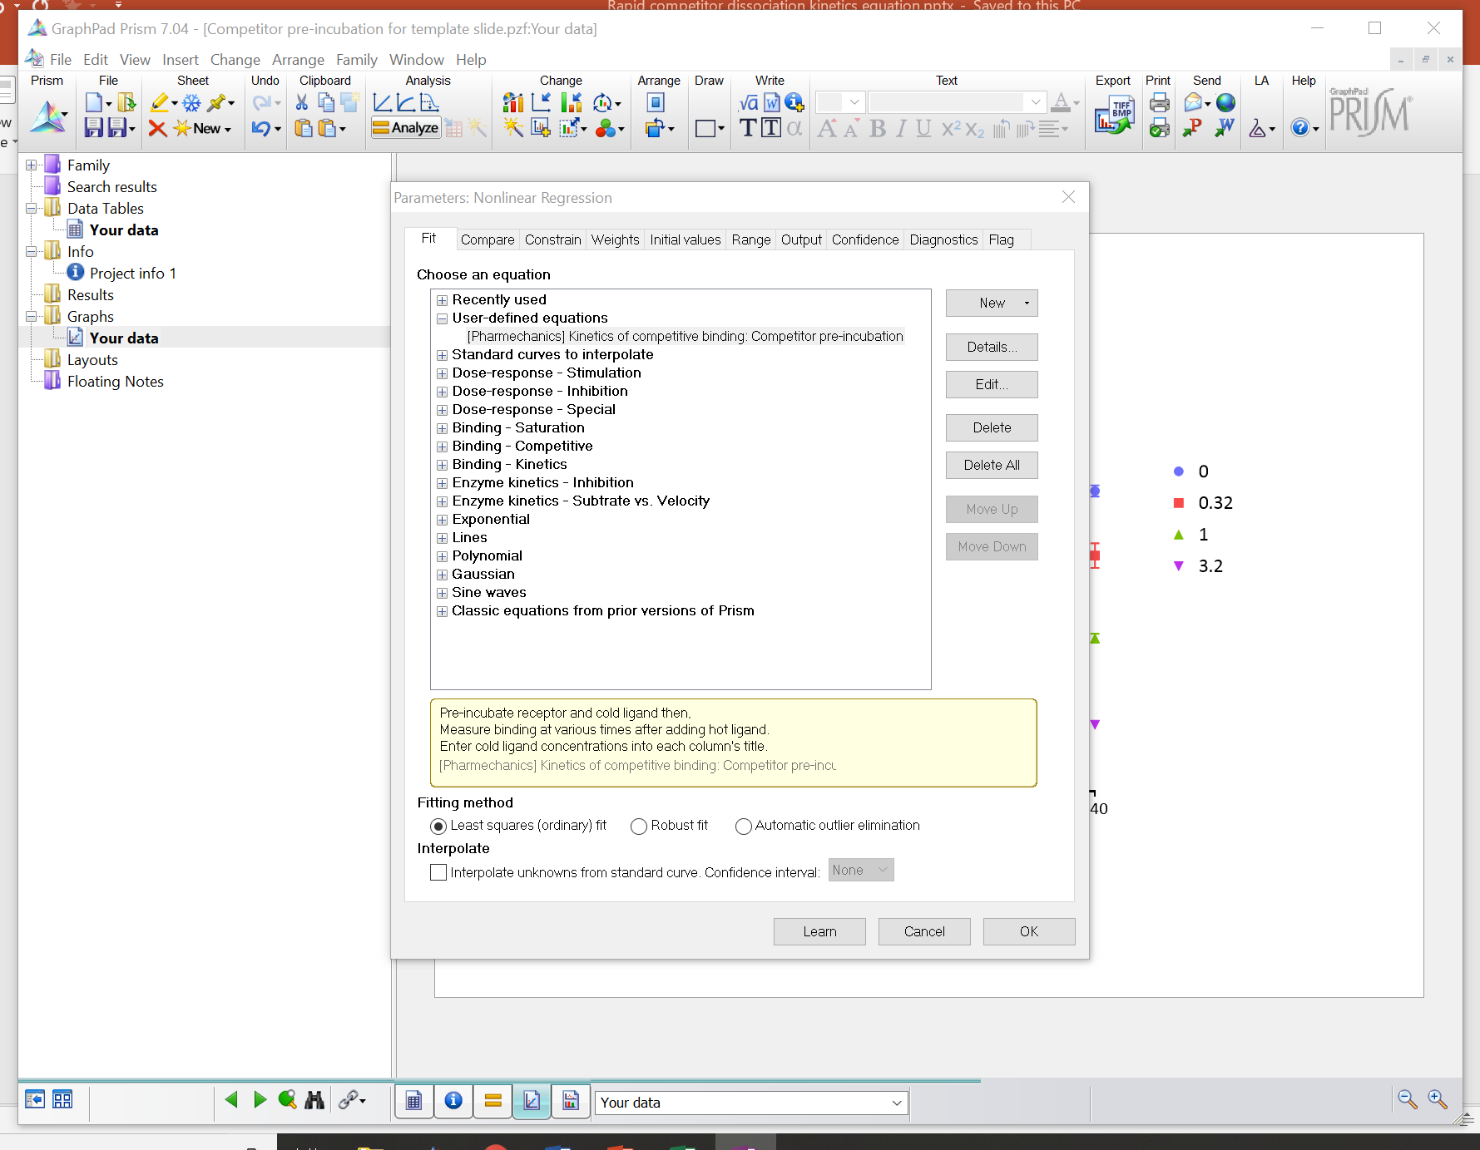
Select equation
Click Details for information on the equation

Slide 20
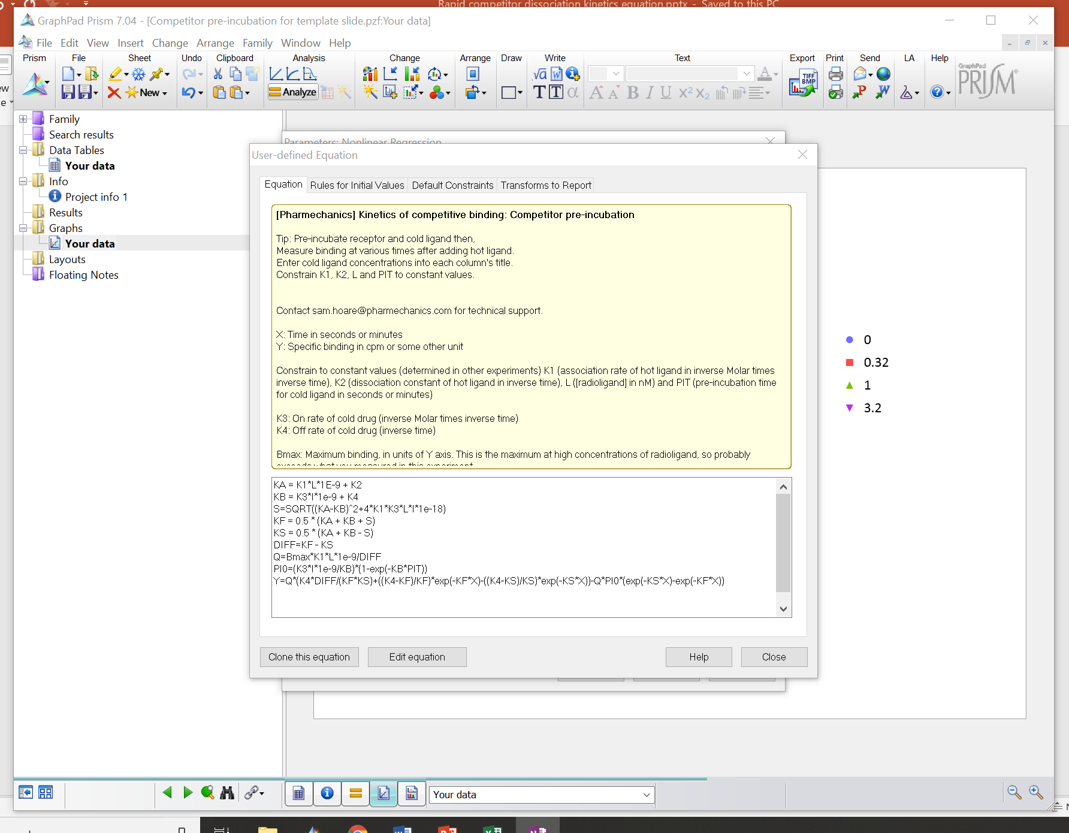
Contact Pharmechanics (not GraphPad) for technical support on the equation.
Equation formatting is the same as for the “Kinetics of competitive binding” equation

Slide 21
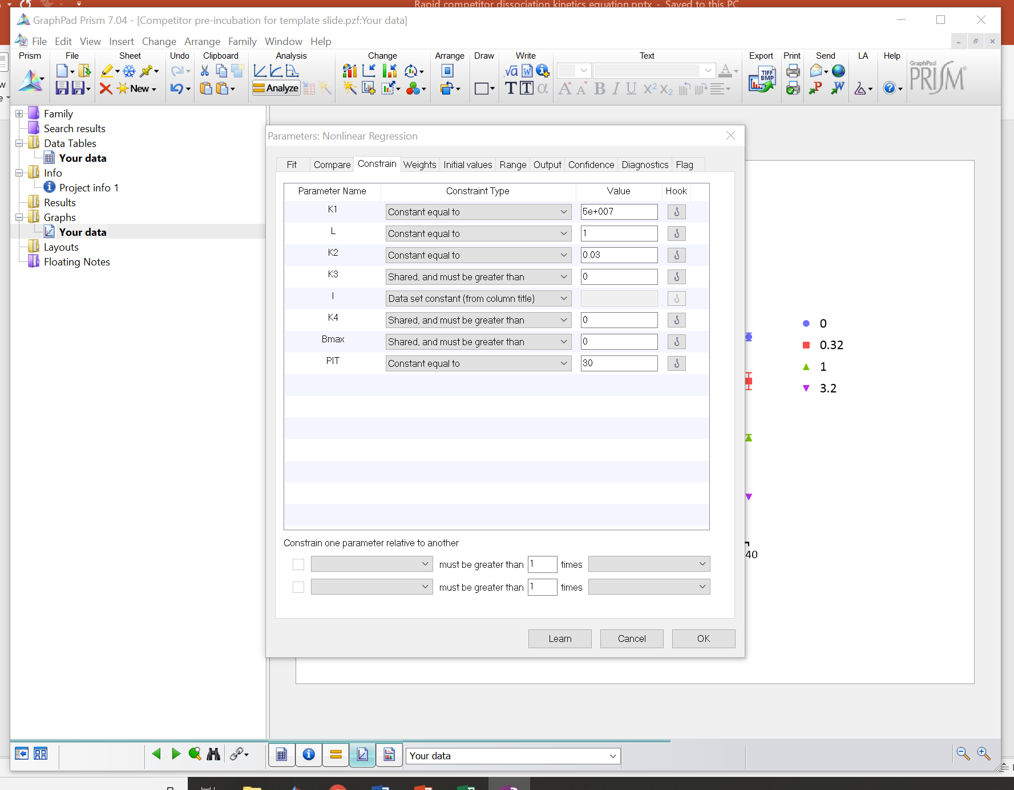
Enter your constant values
Run analysis

Slide 22
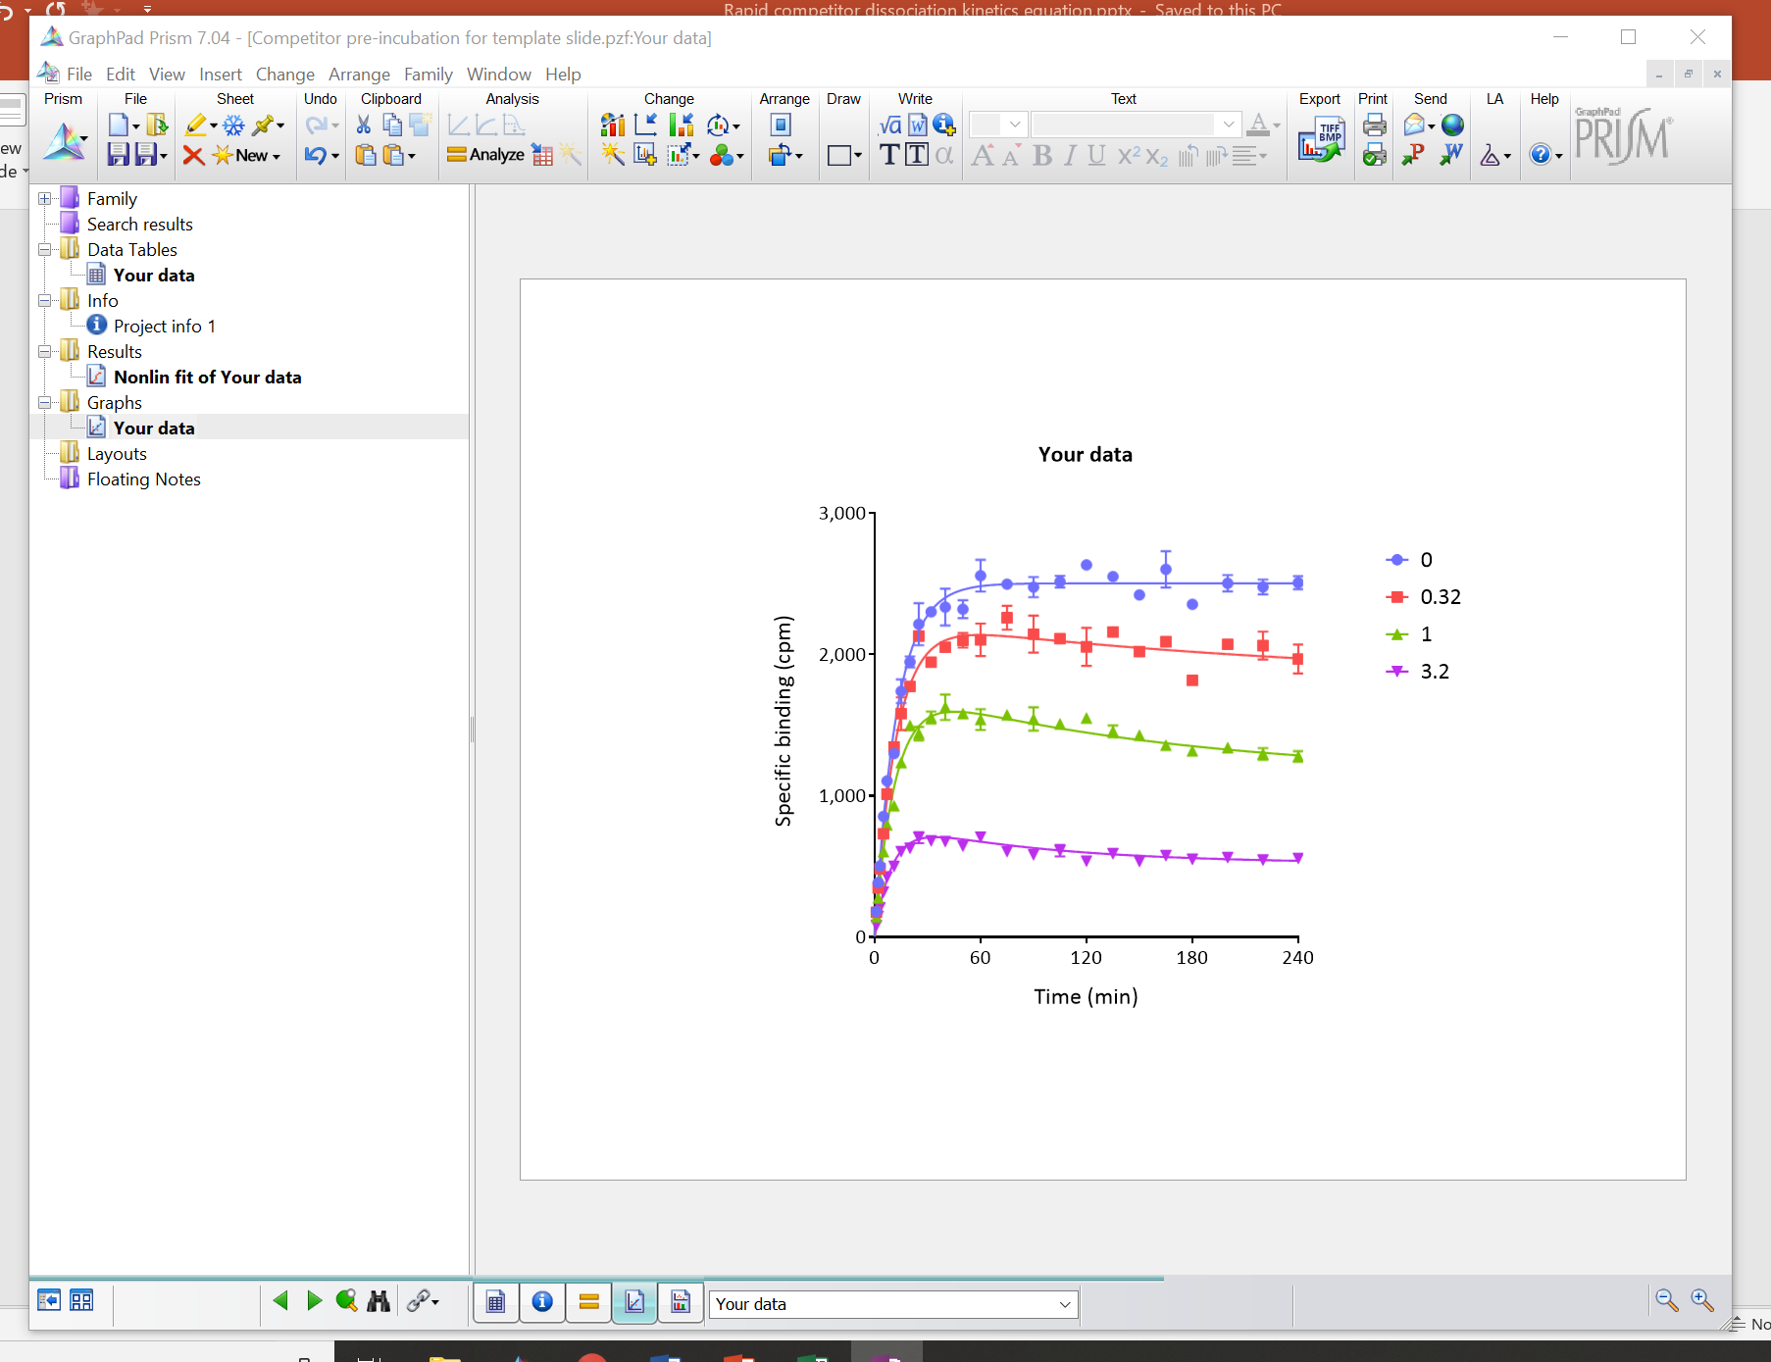

Slide 23
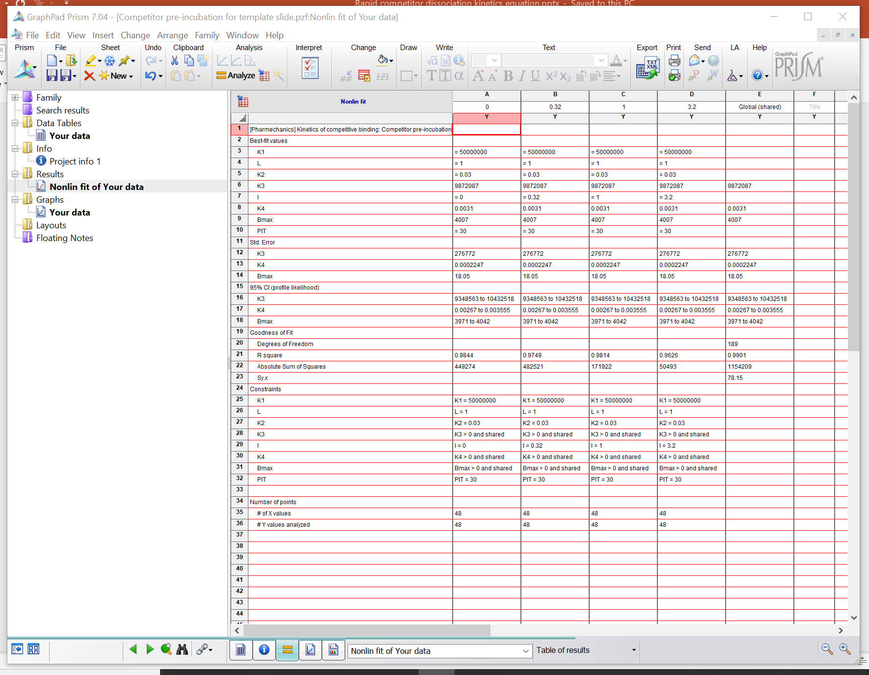

Slide 24
Equation for pre-incubation with labeled ligand
Pre-incubate receptor & labeled ligand
See J Pharm Tox Methods 2018; 89:26-38

Slide 25
Equation for pre-incubation with labeled ligand
Pre-incubate receptor & labeled ligand
Add compound
Measure at various times
See J Pharm Tox Methods 2018; 89:26-38

Slide 26
Equation for pre-incubation with labeled ligand
Pre-incubate receptor & labeled ligand
Add compound
[Compound] (nM)
0
1.0
3.0
10
30
$${\left[RL\right]}_{t}=\frac{N\left[L\right]k_{1}}{K_{F}−K_{S}}\left[\frac{k_{4}\left(K_{F}−K_{S}\right)}{K_{F}K_{S}}+\frac{\left.k_{4}−K_{F}\right.}{K_{F}}e^{−K_{F}t}−\frac{\left.k_{4}−K_{S}\right.}{K_{S}}e^{−K_{S}t}\right]$$
$$+\frac{N[L]k_{1}}{K_{F}−K_{S}}\left(1−e^{−K_{A}t_{PI}}\right)\left(\left.\frac{K_{B}−K_{S}}{K_{A}}\right.e^{−K_{S}.t}−\left.\frac{K_{B}−K_{F}}{K_{A}}\right.e^{−K_{F}.t}\right)$$
Measure at various times
See J Pharm Tox Methods 2018; 89:26-38

Slide 27
Equation for pre-incubation and washout
Pre-incubate receptor & compound
See J Recept Signal Transduct Res 2009, 29: 84-93

Slide 28
Equation for pre-incubation and washout
Pre-incubate receptor & compound
Wash out unbound compound
See J Recept Signal Transduct Res 2009, 29: 84-93

Slide 29
Equation for pre-incubation and washout
Pre-incubate receptor & compound
Wash out unbound compound
Add labeled ligand
Measure at various times
See J Recept Signal Transduct Res 2009, 29: 84-93

Slide 30
Equation for pre-incubation and washout
Pre-incubate receptor & compound
Wash out unbound compound
Add labeled ligand
% bound at 0 min
0 (Control)
10
50
80
90
$${\left[RL\right]}_{t}=\frac{N\left[L\right]k_{1}}{K_{A}}\left[1−\left(1−\frac{ρ_{I\left(t=0\right)}K_{A}}{\left.K_{A}−k_{4}\right.}\right)e^{−K_{A}t}−\frac{ρ_{I\left(t=0\right)}K_{A}}{\left.K_{A}−k_{4}\right.}e^{−k_{4}t}\right]$$
Measure at various times
See J Recept Signal Transduct Res 2009, 29: 84-93

Slide 31
Summary and further information
The Motulsky and Mahan method has been extended to accommodate alternative ordering of reagent addition.
Original Motulsky & Mahan paper
Mol Pharmacol. 1984; 25:1-9
Equation extension papers
J Rec Signal Trans Res. 2009; 29:84-93
J Biomol Screen. 2016; 21:729-37
J Pharm Tox Methods. 2018; 89:26-38
Contact & website
sam.hoare@pharmechanics.com
www.pharmechanics.com

